Slide 1


NEW YORK CITY AIRBNB DATA ANALYSIS REPORT
PRESENTED BY: AFOLAYAN YINKA T.

Slide 2
OUTLINE
INTRODUCTION
PROBLEM STATEMENT
OBJECTIVE
RESEARCH QUESTIONS
DATASET INFORMATION

Slide 3
OUTLINE
DATA CLEANING AND PREPROCESSING
DATA ANALYSIS
DATA VISUALISATION
KEY INSIGHTS
CONCLUSION
RECOMMENDATIONS

Slide 4

INTRODUCTION

Slide 5

WHAT IS AIRBNB?
Airbnb is a short-term rental system where people (Hosts) can rent out their homes or properties for a short period usually ranging from a few days to a few weeks.

Slide 6

AIRBNB IN NYC
New York City offers a unique Airbnb experience for travelers which may not be available through traditional hotels.

Slide 7

PROBLEM STATEMENT

Slide 8
The rise of short-term rental platforms like Airbnb has significantly transformed the hospitality industry.

Slide 9
A comprehensive analysis of the Airbnb dataset is essential to optimize pricing strategies, improve guest satisfaction, and enhance the availability of properties.

Slide 10
OBJECTIVE
This analysis aims to extract actionable insights from the Airbnb dataset to understand the factors influencing listing performance and guest satisfaction.

Slide 11

RESEARCH QUESTIONS
What are the most popular neighborhoods in New York for Airbnb bookings compared to others?
What are the characteristics of highly rated Airbnb rentals in New York City?
How does the price of Airbnb listings vary across different neighborhoods in New York City?

Slide 12
RESEARCH QUESTIONS
How does number of reviews impact the booking rate of Airbnb rentals in New York City?
Is there any correlation between the frequency of reviews and the total number of listings for New York City Airbnb Hosts?

Slide 13

DATASET INFORMATION

Slide 14
DATA SOURCE
DATA OVERVIEW
The Airbnb NYC dataset describes the listings and performance metrics for the year 2019.
The data used for this analysis was sourced from Kaggle.

Slide 15
DATA COLUMNS
The original dataset consists of 16 columns and 48,896 rows.
Id
Name
Host_Id
Host_Name
Neigbhourhood_Group
Neighbourhood
Latitude

Slide 16
DATA COLUMNS
Longitude
Room_type
Price
Mininum_nights
Number_of_reviews
Last_reviews
Reviews_per_month
Calculated_host_listings_count
Availability_365

Slide 17
DATA CLEANING AND PREPROCESSING
The dataset was cleaned in Microsoft Excel before loading to Power BI to remove errors and inconsistencies.
This is necessary to ensure that the data is accurate and ready for analysis.
CALCULATED COLUMN
Last_Review_Year: A new column that contains the year of the last review date was added to the dataset.

Slide 18

DATA ANALYSIS

Slide 19

Key Findings
There were 37,457 unique hosts
There were 349,305 total listings.
The average price for the room types is $152.72.
The average price per stay for Airbnb in New York City is $21.38.

Slide 20
Key Findings
The dataset contains 221 neighbourhoods.
The most common room type is Entire Home/Apt.
Sonder (NYC) emerged as the top host.

Slide 21
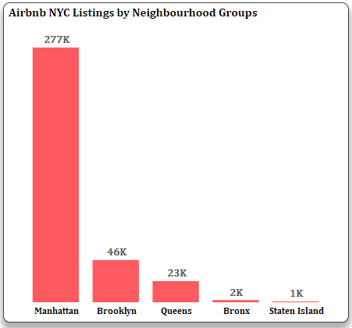
GEOGRAPHIC ANALYSIS
Manhattan has the highest number of Airbnb listings, followed by Brooklyn.
Manhattan is a known hotspot for tourists, thriving business hubs, and cultural activities.

Slide 22
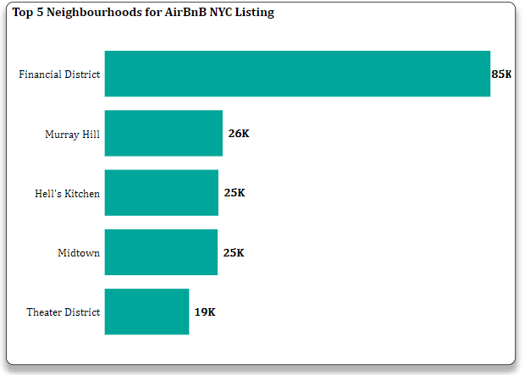
GEOGRAPHIC ANALYSIS
Financial Districts had the highest listings.
This implies that there are more Airbnb properties and higher demand by tourists and business travelers in the area.

Slide 23
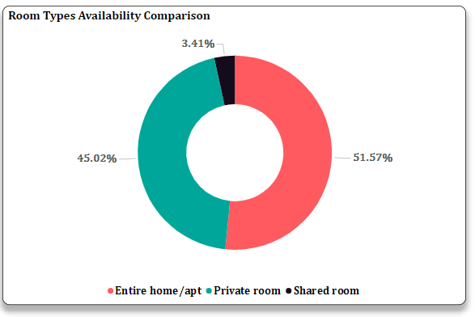
Room Types Analysis
The analysis shows that the “Entire Home/Apt” is the most available Airbnb property.

Slide 24
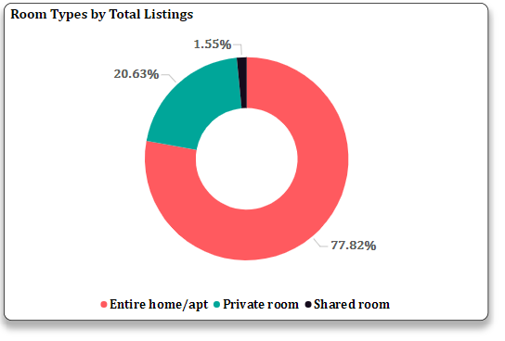
Room Types Analysis
Entire home/apt is the most listed with about 78% of the total listing.
This suggest that Airbnb users prefer renting entire residential spaces for their stays

Slide 25
Pricing Analysis
“Entire home/apt” maintains a higher average price across all the neighbourhood groups which could have been due to the higher demand of “Entire home/apt”.

Slide 26
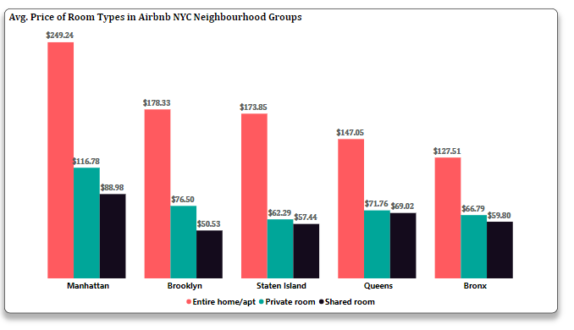
Pricing Analysis
Manhattan stands out as the top-priced neighbourhood group.
Bronx had the most affordable Airbnb listings.

Slide 27
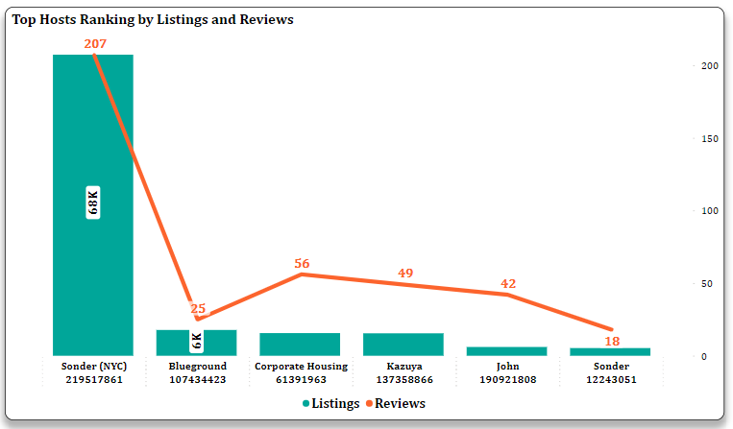
Host Analysis
Sonder (NYC) is the top host with the highest number of Airbnb listings and reviews.
Blueground” had the second highest listings but a relatively low number of reviews.

Slide 28
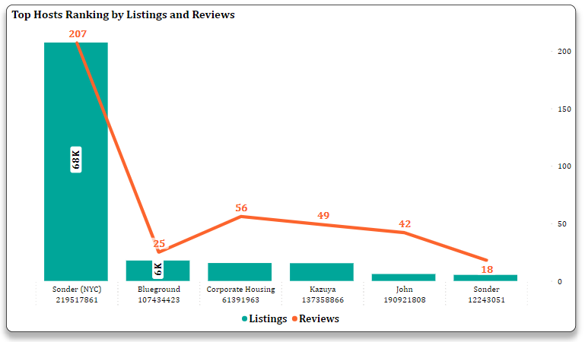
Host Analysis
It is possible that “Blueground” and other hosts did not receive reviews for each listing, leading to a discrepancy between the total number of listings and total reviews.

Slide 29
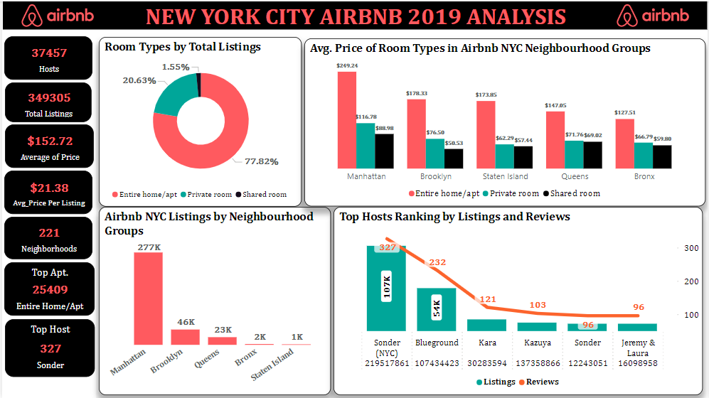
DATA VISUALIZATION

Slide 30
CONCLUSION
Manhattan is the top neighbourhood group in terms of Airbnb listings followed by Brooklyn.
Financial Districts had the highest listings which implies that there are more Airbnb properties and higher demand by tourists and business travelers in the area.

Slide 31
CONCLUSION
Entire home/apt is the most preferred by Airbnb users and also the most expensive room type across all neighbourhood groups.
Sonder (NYC) stands out as the leading host with the most listings and reviews, although the frequency of reviews may have not influenced listing rates by the hosts.

Slide 32

RECOMMENDATIONS

Slide 33


Hosts should actively engage with the guests by offering personalized experiences to enhance their listing performance.
A new review mechanism can be introduced that can motivate guests to share their stories and feedbacks.

Slide 34

ANY QUESTIONS?

Slide 35

THANKS FOR LISTENING

